Slide 1

Collision avoidance simulator in autonomous driving PROJECT SOFTWARE-DEFINED COMMUNICATION SYSTEMS
Umberto Pirovano - Andrea Conese - Andrea Paternò - Hamze Ghorbani Koujani
V0 presentation

Slide 2

ACCOMPLISHED GOALS
Version 0
Identifying requirements and tools setup
Urban scenario modeling
CV model integration
Development environment setup
Windows / Linux
Python
Conda
AirSim setup
Scenario selection & API installation
Moving the car
Storing the images
Computer Vision
Research of models and datasets
Comparing different CV models
Integration of the chosen solution

Slide 3
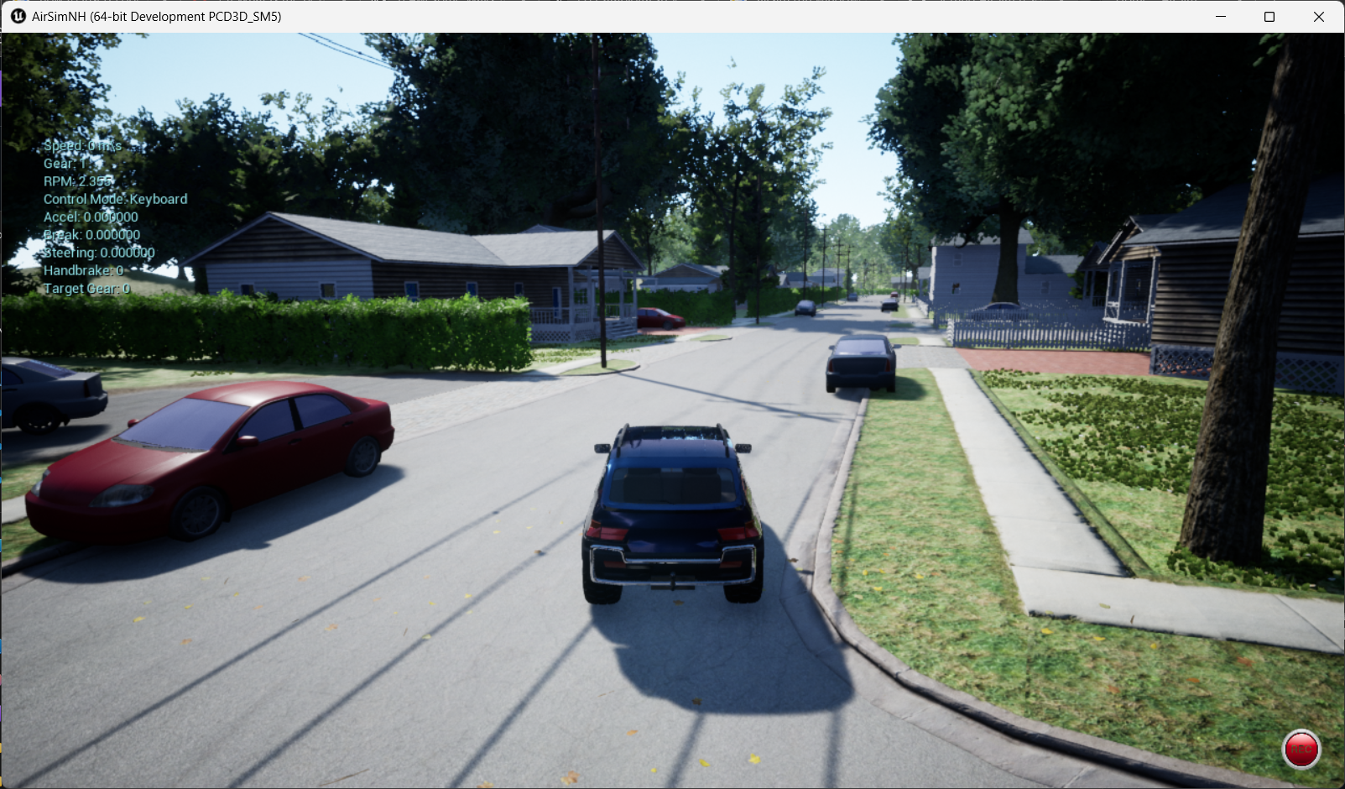
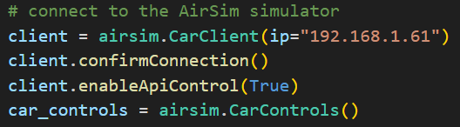

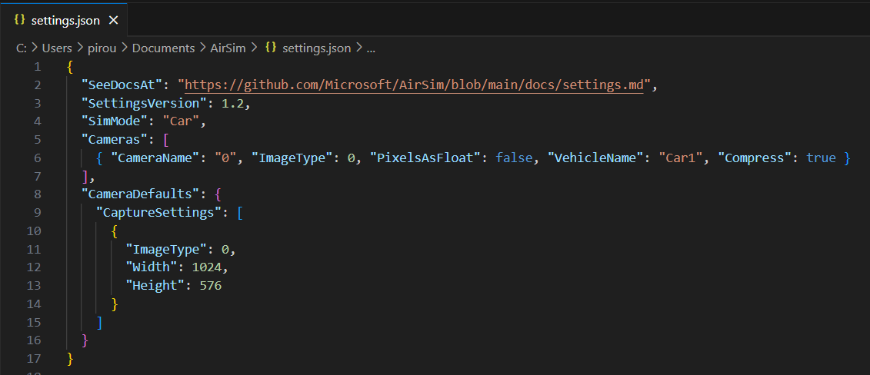
AIRSIM SETUP

Slide 4


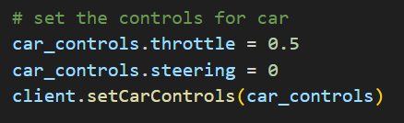
CONTROLLING THE CAR & STORING THE IMAGES
Temporary
solution

Slide 5
MODEL COMPARISON
CV MODELS | TASK | DATASET | EXECUTION TIME (seconds)* (one image)
YoloV8-m | Object detection | COCO | 0.012
MMdetection Faster R-CNN | Object detection | Cityscapes | 0.763
MMsegmentation DeepLabV3+ | Instance segmentation | Cityscapes | 1.807
* NVIDIA RTX 2060 MOBILE, CUDA 12.4

Slide 6

YOLO V8

Slide 7

MMdetection – Faster R-CNN

Slide 8
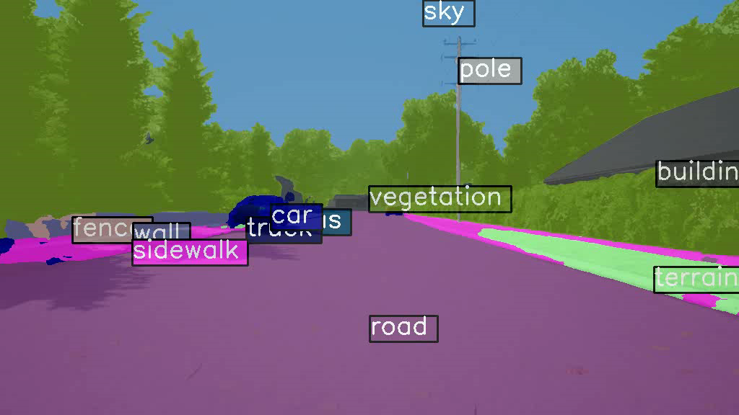
Mmsegmentation – DeepLabV3+

Slide 9
Gantt Chart
TODAY
Initiative | Objective | April 1 | April 2 | April 3 | April 4 | May 1 | May 2 | May 3 | May 4 | June 1 | June 2 | June 3 | June 4
Version 0 | Simulate the urban scenario in AirSim and achieve video frames.
 | Prepare the data and feed it to the CV model and detecting objects.
 | Basic results’ analysis
Version 1 | Measure the distance from detected objects. Providing steering and speed change information.
 | Establish a IEEE 802.11ax channel simulator, transmitting images from airsim to CV model.
 | Refine the channel simulator to send steering data back to theAirsim. Integrate the whole project.
 | Results’ analysis and evaluation
Version 2 | Develop GUI for the final project. Prepare detailed reports.

Slide 10

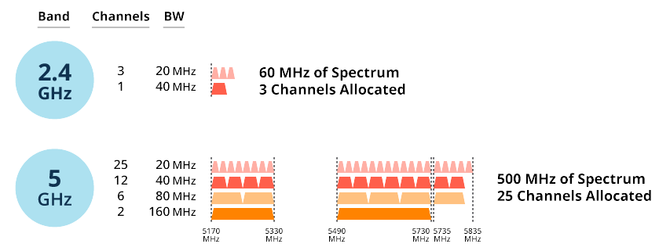
… FUTURE PLANS
Version 1
Wireless channel simulator establishment
Path logic development
Results’ analysis
System assessment based on KPIs

Slide 11
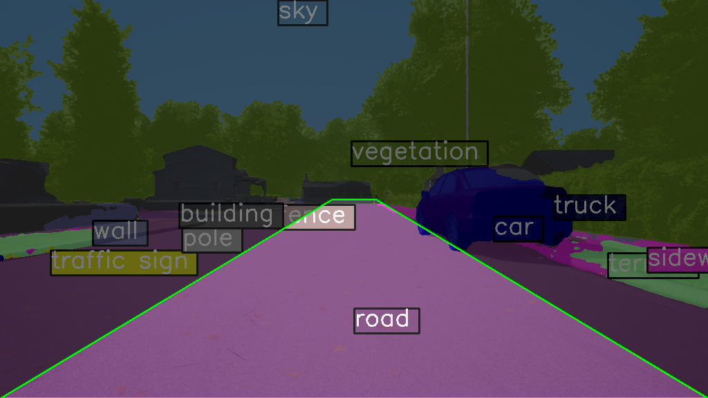
… FUTURE PLANS
Version 1
Wireless channel simulator establishment
Path logic development
Results’ analysis
System assessment based on KPIs
Define a Region Of Interest (ROI)

